Slide 1
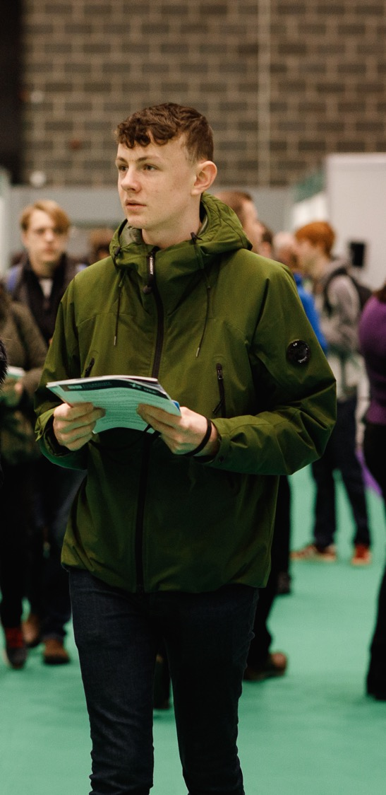
Get ready to visit...

Slide 2
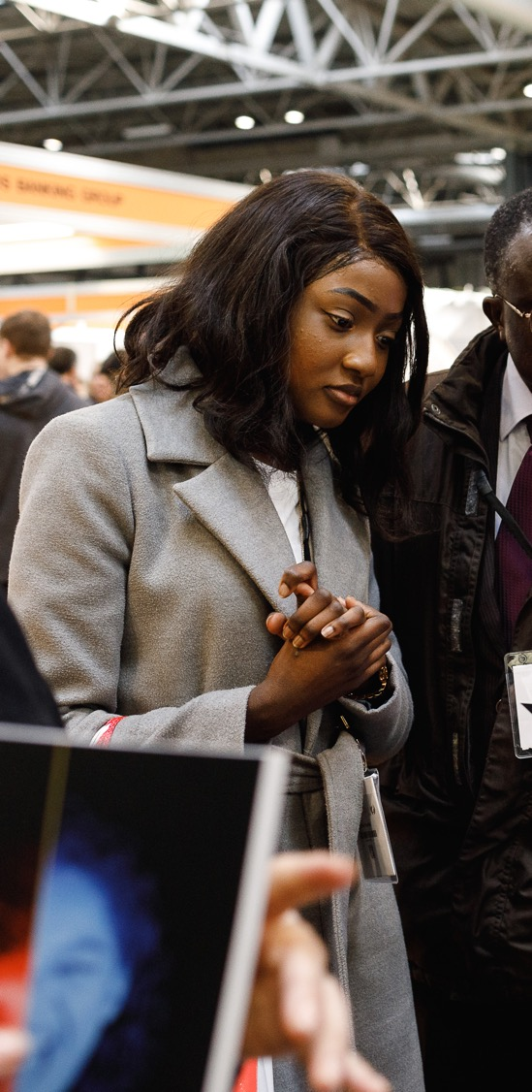
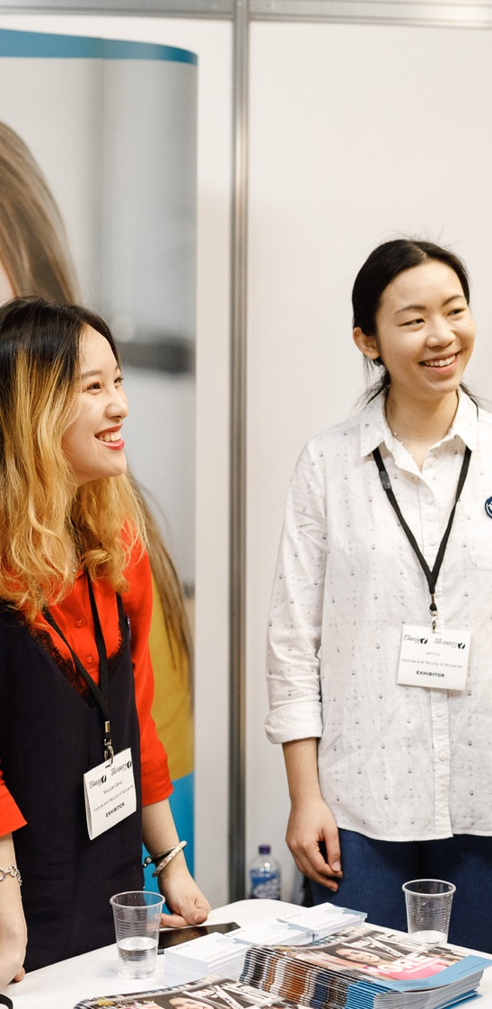


Before you visit
  Check out what’s going on at the event by visiting WhatLive.co.uk
  Think about the questions you’d like to ask uni reps, apprenticeship providers and careers advisers
  Note down the times of any talks you’d like to watch
  Sign up to the What Next? newsletter for the latest updates about the event
  Follow the event on social media: #WhatLive
  What Next? @WhatCareerLive

Slide 3

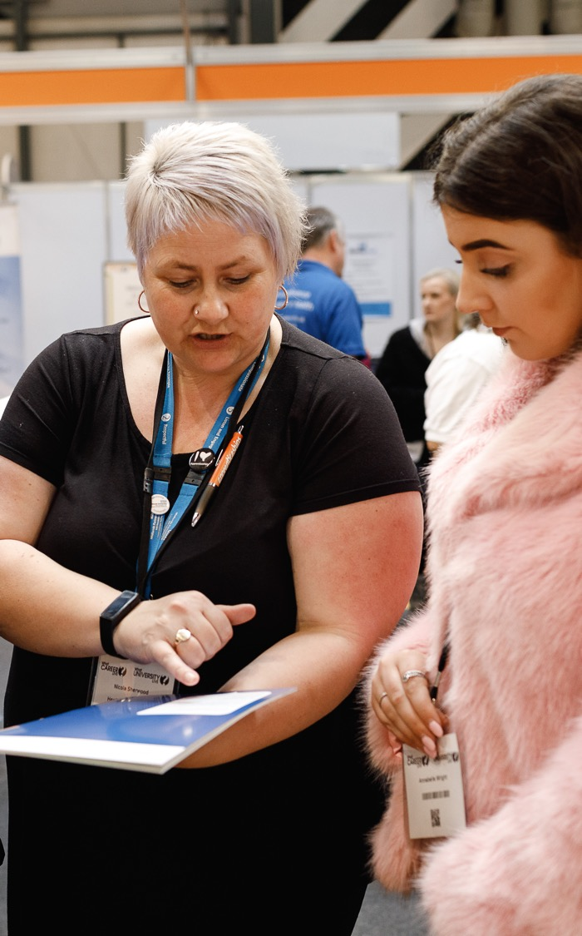
Sample questions for companies on the day
  What does your company do?
  What careers do you offer?
  What qualifications do I need?
  What training and apprenticeships are available?
  Where is the apprenticeship based?
  What would I do in an average day?
  Where could I be in 5 years’ time?
  How much can I earn?
  How do I apply for an apprenticeship with you?
  How can I make my application stand out?

Slide 4
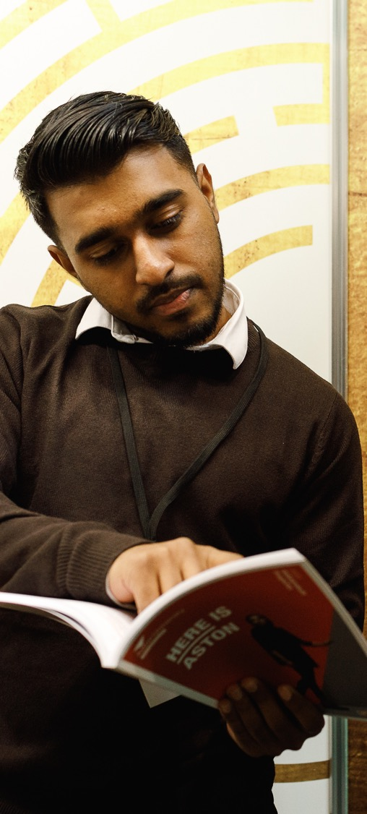

Sample questions for universities on the day
  What grades do need for this course?
  What do you look for in an application
  and personal statement?
  Do you hold interviews or is selection
  based on UCAS application?
  Is it a campus university?
  Where is the university located?
  What is student accommodation like?
  What sports societies are available?
  How many hours per week are involved in this course?
  How will this course make me more employable?
  What have previous students gone on
  to do after graduating?

Slide 5



Our final top tips
  Plan – before you attend the event make sure you have researched who you want to meet (full exhibitor list on website) and have questions ready
  Don’t be shy – all the exhibitors are there to speak to you about your options
  Interact – exhibitors may have ways you can explore what they do on their stand, have a go and help determine your future
  Don’t – just collect bags of brochures and leave them forgotten in your room. Take a look at them while the event is fresh in your mind. Consider booking onto a university open day, or researching apprenticeship application deadlines.

Slide 6
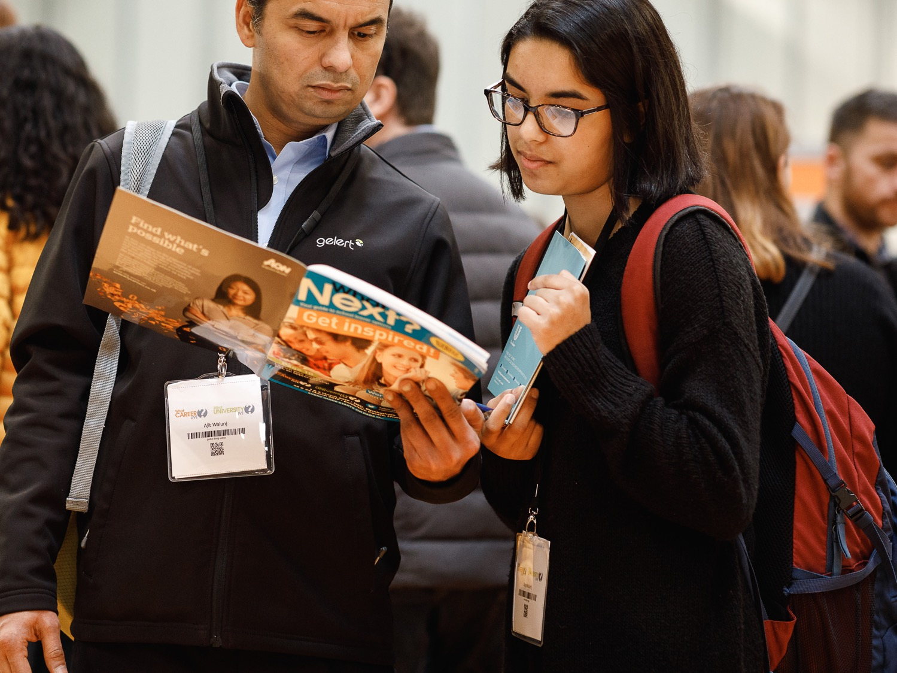
Anything else?
  Bring a notebook, pen and CV if you have one
  Take part in the free workshops and listen to the talks on offer
  Make sure you know where you are meeting your group and at what time to avoid holding everyone up!

Slide 7
See you at the show!
WhatLive.co.uk

